Slide 1
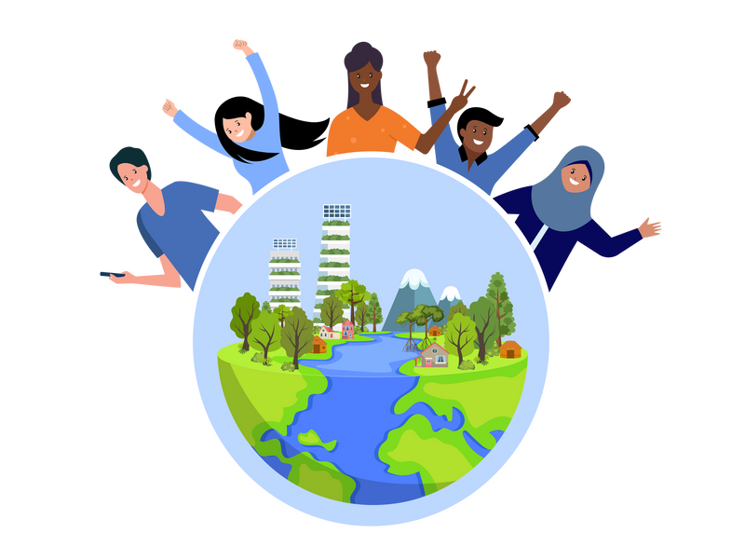
Business Model Canvas
Problem:
Solution:
Value Proposition
Users:
• LIC members getting available safe water at doorsteps in a half price than before.
• Finding no way local traders in the neighboring slums reduce the costs.
• Due to collective ownership it is accessible to all. Most importantly by being involved in the system they get rid of the dependency on private water traders.
Scalers:
Actors (municipal authorities and NGOs producers) want to address water crisis and build resilience would find it as a feasible solution which could be scale up easily in collaboration with Private Sector.
Private sector manufacturer/input sellers who wants to increase their market would find the system as an opportunity to sell out water pumps and accessories in instalments which would help minimize upfront costs.
Comparative Advantage:
"Customer" Segments:
Users:
· Urban Low income community specially women.
· Slum dwellers with high dependency on local water traders or surplus water of nearby factories/industries.
Scalers:
· NGOs/Community entrepreneurs
· Public & private sector
· City Corporation
Low Income Communities (LIC) in urban Bangladesh do not have access to safe, reliable and adequate water for domestic consumption.
Municipal authorities do not supply water in the slums as they are out of formal holding tax process. LICs have no choice but to rely on local traders for water at a higher price. To meet domestic needs, women spend 3-4 hours a day in the queue to fetch water and often they face harassment. Limited access to safe water results into various water borne diseases. Lack of water sources in those highly compacted areas, increases the risk of fire incidents. In urban slums, water is a high-value service. Poor people are dependent on local water traders and have to purchase water at a higher price even than the rich people pay for water. People are helpless because there is no municipal water connection or no other sources of pure water. Women have to spend longer time for water collection. It has a negative impact on health issue as well. Water borne diseases are common and particularly acute during the rainy season, when people use contaminated unhygienic water. Slums are prone to fire hazard as well and lacks water source to douse the fire.
‘The Water Collective’ is a community managed women friendly solution co-created by CARE in co-financing mechanism to solve out water scarcity of the slums.
The system, where communities have full control, ensured access to safe water 24/7 at a cheater price at their doorsteps.
A group of selective community members voluntarily collects the fees from households to manage operational costs and maintenance. Remaining balance is being deposited in bank. The water collective has a formal links with the municipal authority for sustainability.
• LIC members especially women and girls can access to safe running water at doorsteps. It reduces risk of gender based violence and increases women’s productive time.
• It helps women and adolescent girls to maintain their menstrual hygiene.
• It reduces the risk of water borne diseases.
• It increases the community resilience against fire. The system has fire hydrant inbuilt with hose-pipe to extinguish fire at the very beginning.
Key Metrics:
Channels:
1. Water cost has been reduced (nearly halved).
2. According to community, fire incidents are now lower than before.
3. Water borne diseases get visibly lower.
4. Incidents of Gender Based Violence has been reduced.
To reach users: The Key benefit (low cost & availability) attracts the customers from adjacent communities. Additionally, meeting, social gathering, community marketing, group formation is helping to reach users.
To reach scalers: National events, advocacy, meeting with private sector, local elected bodies and City Corporations; social networking, blogs, publicity materials etc.
Cost:
Revenue Streams:
• Monthly collection fee
• There is a bank account for the Water Collective where the monthly fees from customers get deposited. A small amount of Interest also came from bank savings.
The approximate cost for the establishment of water supply system is USD 5318.75 on an average, if it is solely carried over by CARE project along with community co-financing up to 23-36% (approx. USD 2,133.05) for pipeline networking, electricity connection and others.
But if we go in a private sector partnership approach, then the upfront cost could be minimized in a large scale as there will be installment/community entrepreneurship. Each system covers 100-150 households.
Non-financial Resources:
• Land
• Oriented and skilled staffs
• Community mobilization
• Water management committee
• Voluntary labor from community
• The model itself

